Slide 1
Non-Local Mean
A. Buades, B. Coll and J. -. Morel, "A non-local algorithm for image denoising"
Jingqi Zhang
Jefferson Zhong

Slide 2
01
Problem Definition
02
Previous Work
03
Non-Local Mean
04
Implementation
CONTENTS
05
Comparisons
06
Limitations & Further Work

Slide 3
Problem
Definition

Slide 4
Problem Definition
What is Noise
Unwanted information which deteriorates image quality
Due to illumination, temperature, or signal processing disturbances etc.

Slide 5
Problem Definition
Common Noises
Salt and Pepper Noise
Sparse white and black pixels
Caused by camera heat, dust etc.
Image Source: https://en.wikipedia.org/wiki/Image_noise#/media/File:Noise_salt_and_pepper.png

Slide 6
Problem Definition
Common Noises
Gaussian Noise
Gaussian distributed
Good model of noise in many images
Poor lighting, heat, transmissions etc.
Image Source:
https://www.researchgate.net/figure/Noisy-image-Gaussian-noise-with-mean-and-variance-0005_fig2_252066070

Slide 7
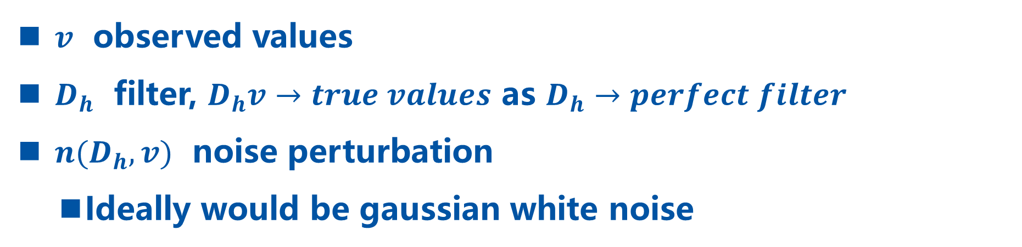
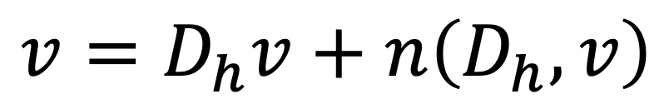
Problem Definition
Image Denoising
Goal
Recover the original image from noisy image.
$$v=D_{h}v+n\left(D_{h},v\right)$$
$v$ observed values
$D_{h}$ filter, $D_{h}v→true values$ as $D_{h}→perfect filter$
$n(D_{h}, v)$ noise perturbation
Ideally would be gaussian white noise

Slide 8
Previous
Work

Slide 9
Previous Work
Local Smoothing Filters
Collect information from adjacent pixels to smooth out disturbance.
Denoising by Averaging

Slide 10
Local Smoothing Filters
Gaussian Filtering
Optimal in flat parts of the image
Blurred around edges and texture
Anisotropic Filtering
The straight edges are well restored
Flat and textured regions are degraded
Neighborhood Filtering
- Not robust when images is very noisy

Slide 11
Motivation
Local Filters Disadvantages
Visual Quality:
Either edge or texture details are degraded
Method Noise:
Smooths out even when the image has not much noise
What if we consider non locally?

Slide 12
Non-Local Mean

Slide 13
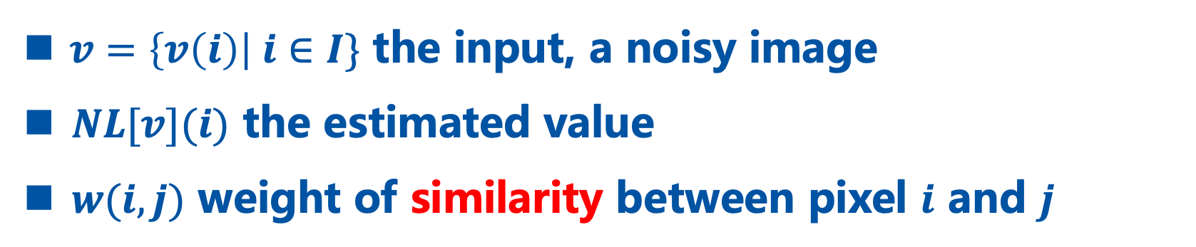
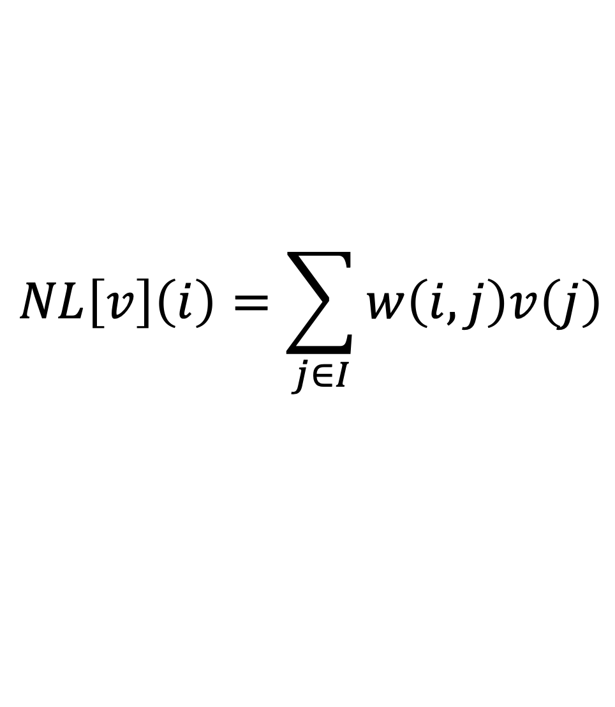
Non-Local Mean
Denoising with weighted average across all pixels.
Definition
$$NL\left[v\right]\left(i\right)=\sum_{j∈I}{w\left(i, j\right)v\left(j\right)}$$
$v=\left\{v\left(i\right)\right| i∈I\}$ the input, a noisy image
$NL[v](i)$ the estimated value
$w(i, j)$ weight of similarity between pixel $i$ and $j$

Slide 14
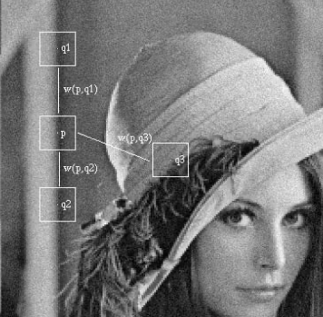
Weight of Similarity Motivation
want to denoise patch p
Weight of q1 should have value larger than q3, since they are similar
q3
q1
p
Image Source: A. Buades, B. Coll and J. -. Morel, "A non-local algorithm for image denoising"

Slide 15
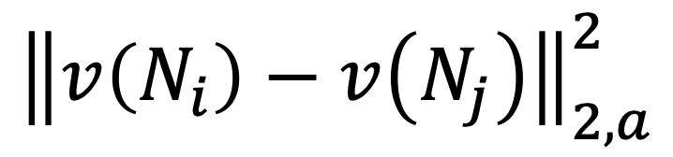
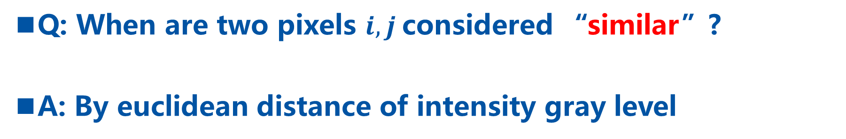
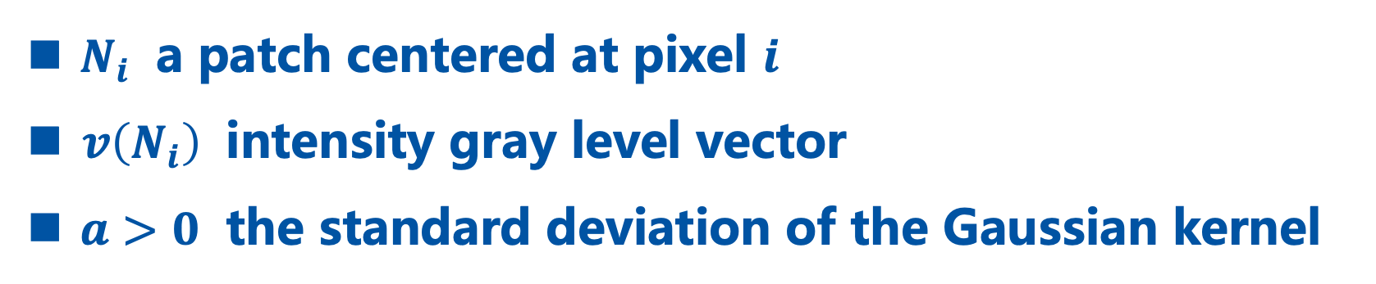
Similarity Defined
Q: When are two pixels $i, j$considered “similar”?
A: By euclidean distance of intensity gray level
$${\left\|v\left(N_{i}\right)−v\left(N_{j}\right)\right\|}_{2, a}^{2}$$
$N_{i}$ a patch centered at pixel $i$
$v\left(N_{i}\right)$ intensity gray level vector
$a>0$ the standard deviation of the Gaussian kernel

Slide 16
Weight of Texture Motivation
Also want to respect texture
Pixels nearby have similar texture thus should be weighted more
q1, q3 same intensity, but q1 preserves texture
q1
p
q3
Image Source: A. Buades, B. Coll and J. -. Morel, "A non-local algorithm for image denoising"

Slide 17
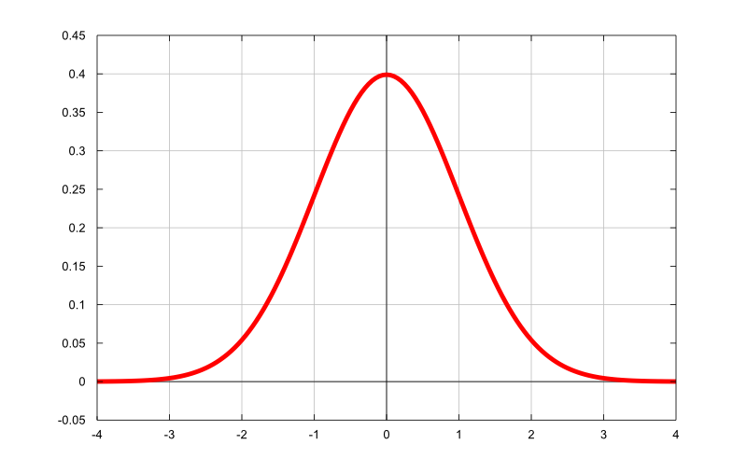
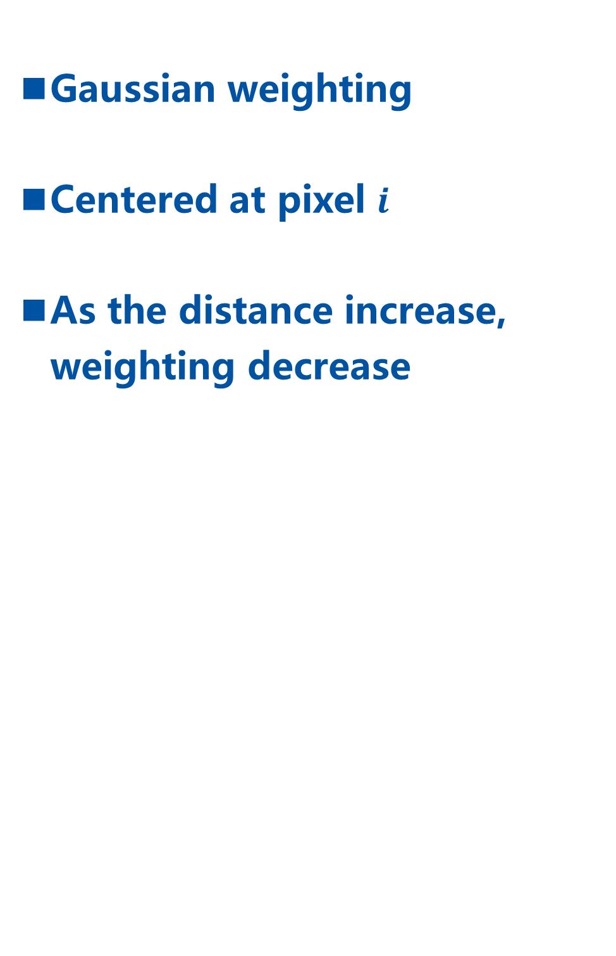
Weight of Texture Motivation
Gaussian weighting
Centered at pixel $i$
As the distance increase, weighting decrease
weighting
distance

Slide 18
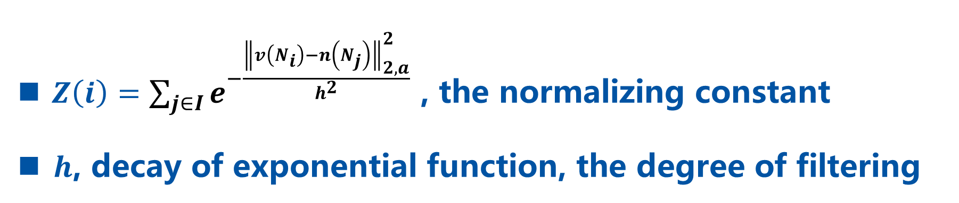
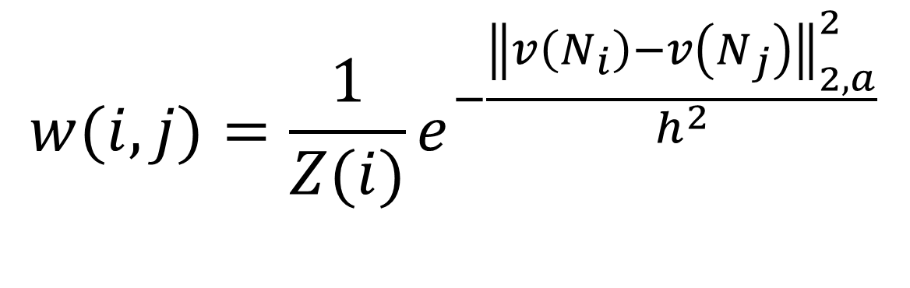
Weights Defined
Patches close together with a similar grey level have larger weights.
$$w(i, j)=\frac{1}{Z(i)}e^{−\frac{{\left\|v\left(N_{i}\right)−v\left(N_{j}\right)\right\|}_{2, a}^{2}}{h^{2}}}$$
$Z\left(i\right)=\sum_{j∈I}{e^{−\frac{{\left\|v\left(N_{i}\right)−n\left(N_{j}\right)\right\|}_{2, a}^{2}}{h^{2}}}}$ , the normalizing constant
$h$, decay of exponential function, the degree of filtering

Slide 19
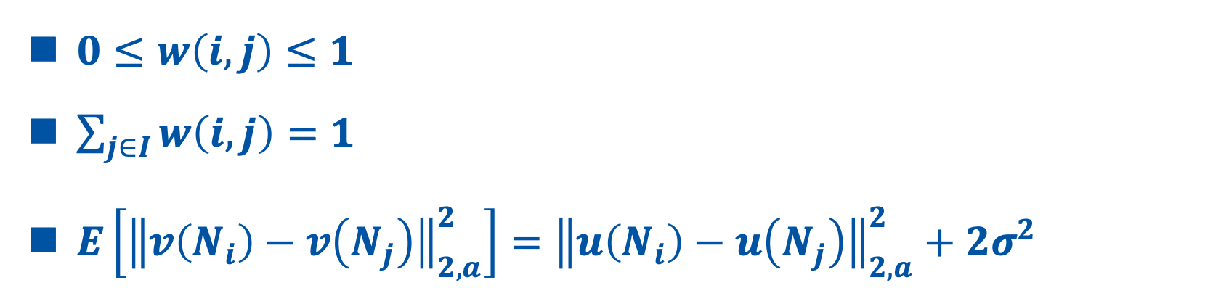
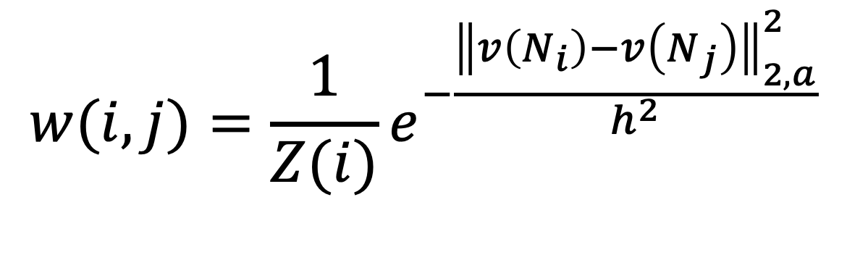
Weights Defined
Patches with a similar grey level have larger weights
$$w(i, j)=\frac{1}{Z(i)}e^{−\frac{{\left\|v\left(N_{i}\right)−v\left(N_{j}\right)\right\|}_{2, a}^{2}}{h^{2}}}$$
Properties
$0≤w\left(i, j\right)≤1$
$\sum_{j∈I}{w\left(i, j\right)=1}$
$E\left[{\left\|v\left(N_{i}\right)−v\left(N_{j}\right)\right\|}_{2, a}^{2}\right]={\left\|u\left(N_{i}\right)−u\left(N_{j}\right)\right\|}_{2, a}^{2}+2σ^{2}$

Slide 20
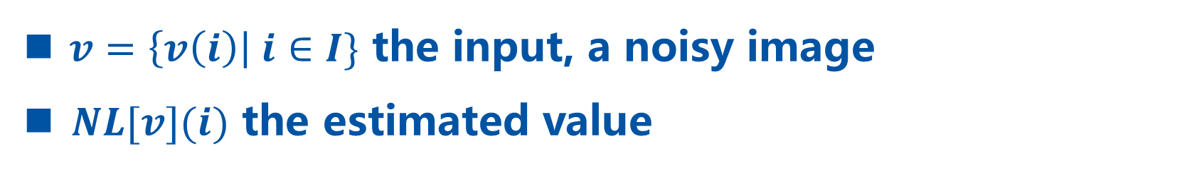
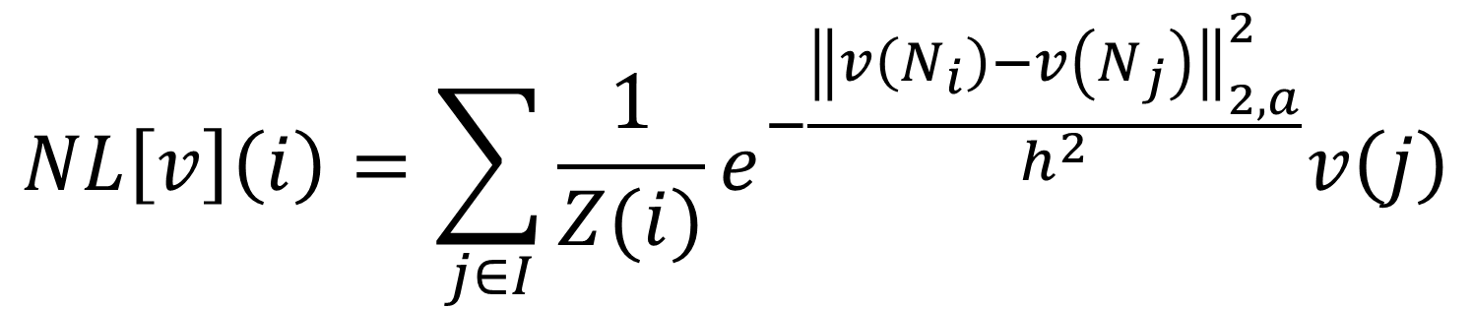
Non-Local Mean
Putting together
$$NL\left[v\right]\left(i\right)=\sum_{j∈I}{\frac{1}{Z(i)}e^{−\frac{{\left\|v\left(N_{i}\right)−v\left(N_{j}\right)\right\|}_{2, a}^{2}}{h^{2}}}v\left(j\right)}$$
$v=\left\{v\left(i\right)\right| i∈I\}$ the input, a noisy image
$NL[v](i)$ the estimated value

Slide 21
Implementation

Slide 22
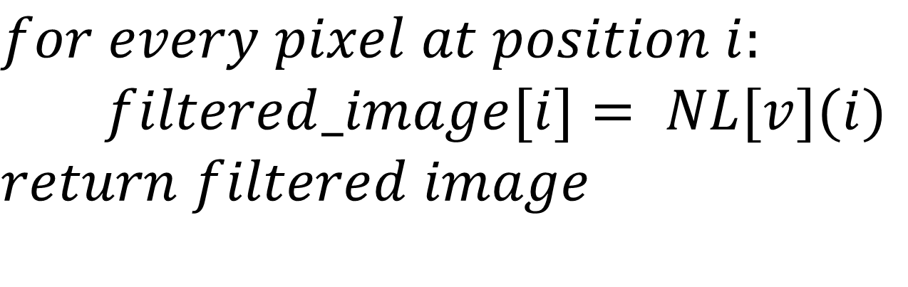
Non-Local Mean
Algorithm
$$for every pixel at position i:$$
$$filtered_image[i]= NL[v](i)$$
$$return filtered image$$

Slide 23
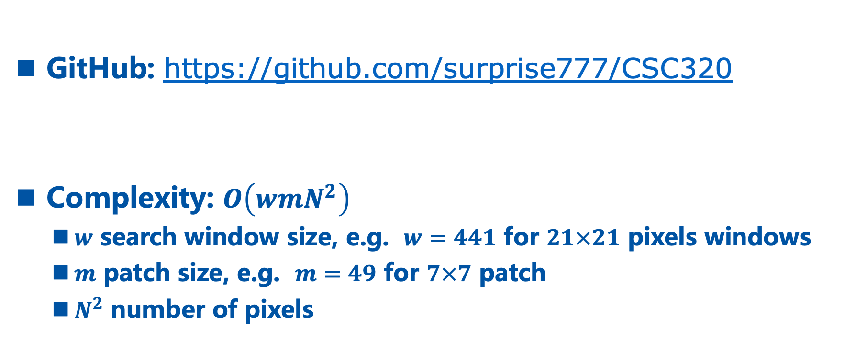
Implementation
Code
GitHub: https://github.com/surprise777/CSC320
Complexity: $O\left(wmN^{2}\right)$
$w$ search window size, e.g. $w=441$ for $21×21$ pixels windows
$m$ patch size, e.g. $m=49$ for $7×7$ patch
$N^{2}$ number of pixels

Slide 24
Comparisons

Slide 25
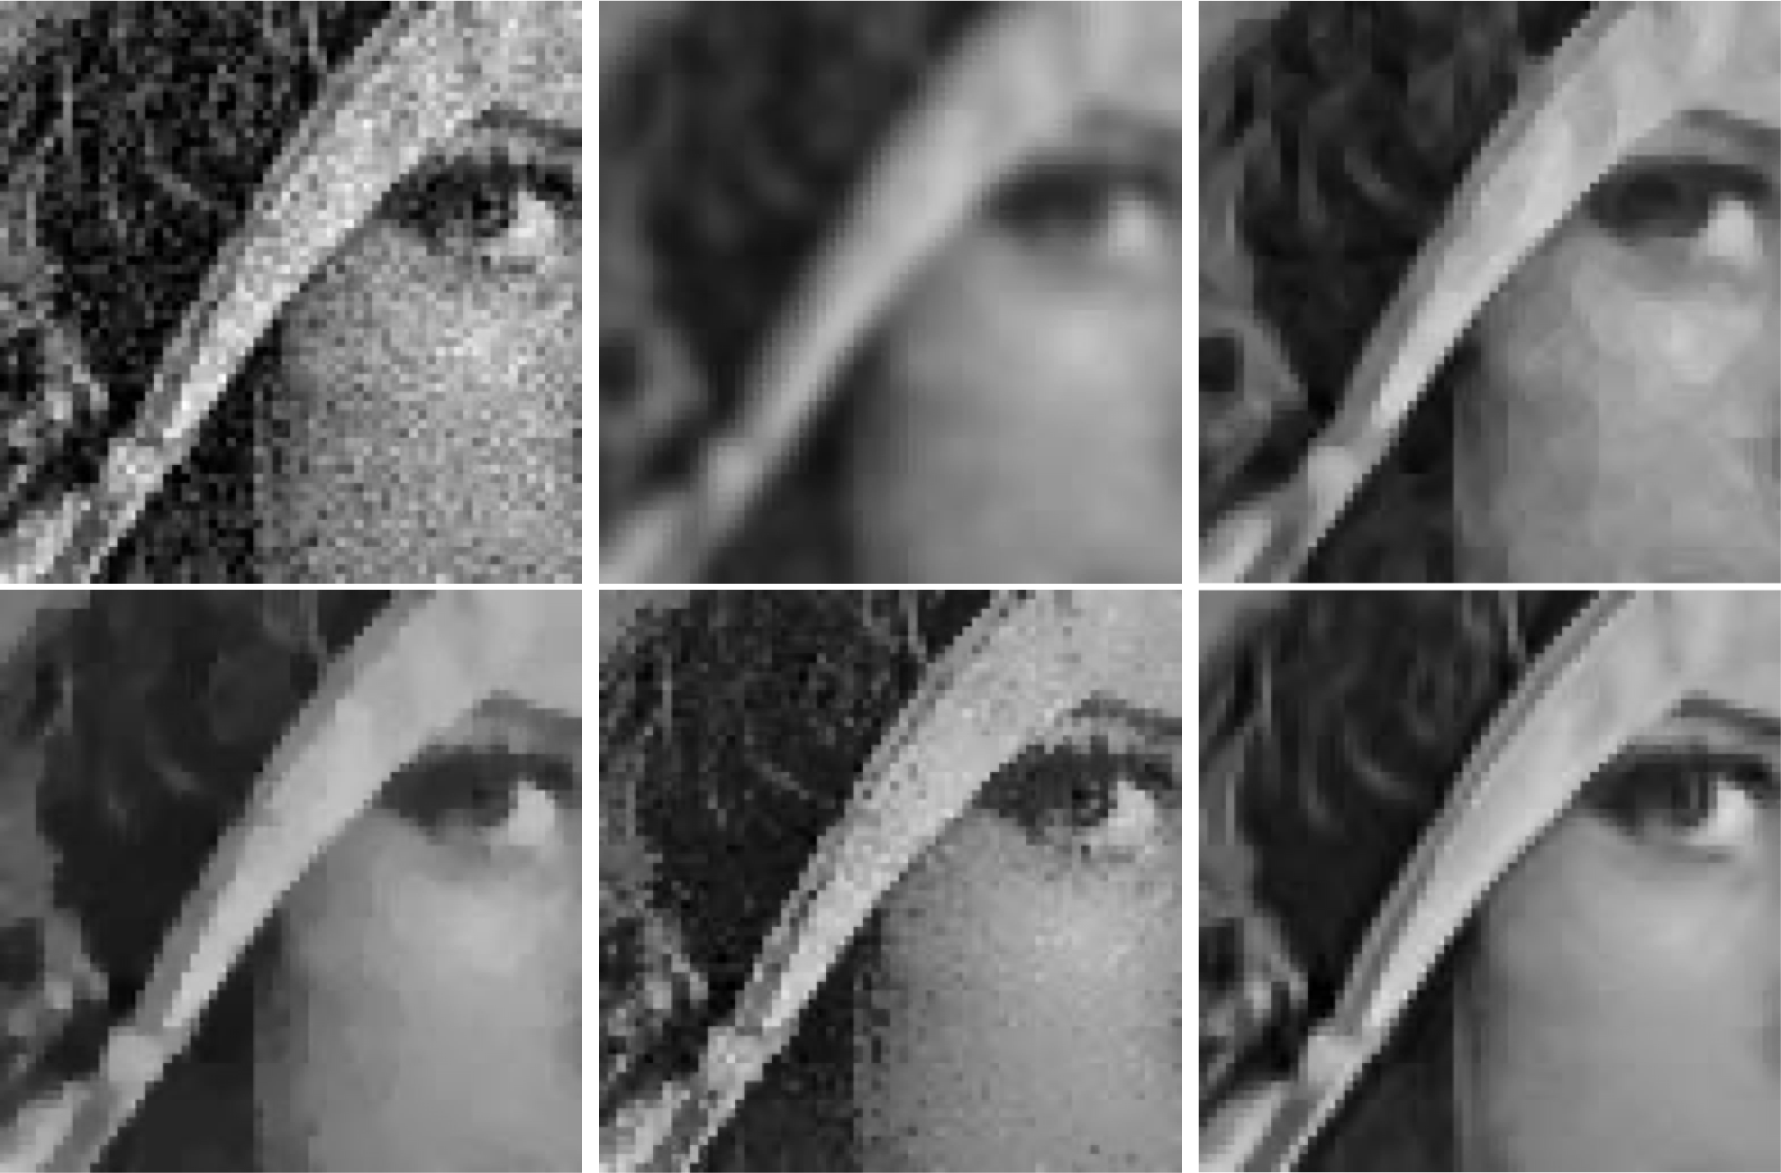
Comparisons – Visual Quality
Preserves more detail on edge and texture
Noisy Image
Gauss Filtering
Anisotropic Filter
Total Variation
Neighborhood Filtering
Non-Local Mean
1 2 3
4 5 6
Image Source: A. Buades, B. Coll and J. -. Morel, "A non-local algorithm for image denoising"

Slide 26
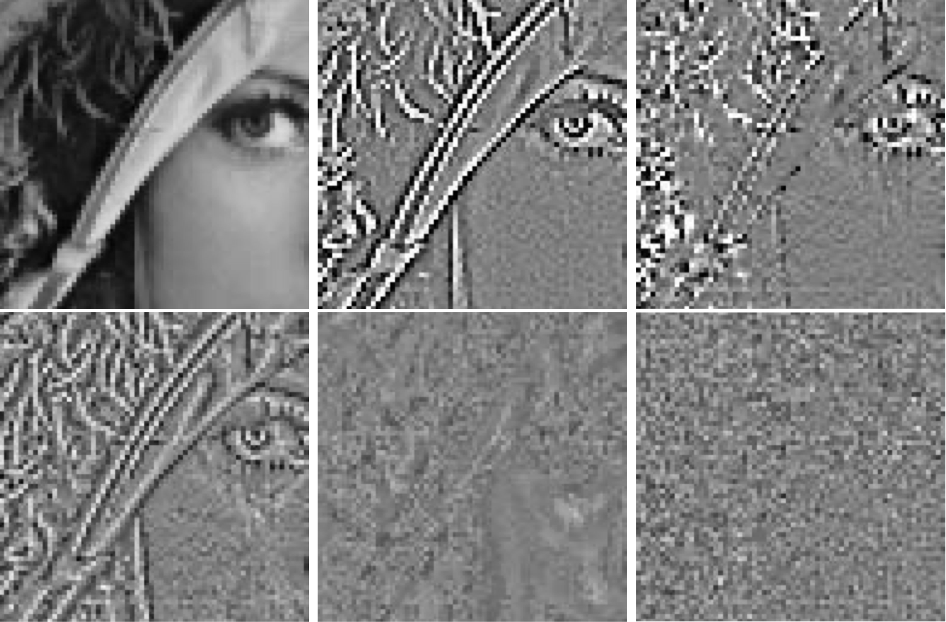
Comparisons – Method Noise
Method noise looks like Gaussian white noise
1 2 3
4 5 6
Noisy Image
Gauss Filtering
Anisotropic Filter
Total Variation
Neighborhood Filtering
Non-Local Mean
Image Source: A. Buades, B. Coll and J. -. Morel, "A non-local algorithm for image denoising"

Slide 27
Limitations &
Further Work

Slide 28
Limitations & Further Works
01
Efficiency Concern
Super slow, cannot be used on device that requires instant result e.g. phone
When number of patches is too large or the image is too noisy, will require infeasible time to detect similarities
Further work on improving runtime:
Thaipanich T, Oh BT, Wu PH, Xu DR, Kuo CCJ (2010) Improved image denoising with adaptive nonlocal means (ANL-means) algorithm.
Karnaukhov, V.N., Mozerov, M.G. Fast Non-Local Mean Filter Algorithm Based on Recursive Calculation of Similarity Weights.

Slide 29
Limitations & Further Work
02
Types of Noise to Filter
Original algorithm designed toward additive noise e.g. Gaussian noise, but not so much in multiplicative noise e.g. Speckle noise
Speckle noise often appear in Ultrasonic Imaging
Further work on extension toward multiplicative noise:
Teuber T., Lang A. (2012) Nonlocal Filters for Removing Multiplicative Noise.
Radlak K., Smolka B. (2014) Adaptive Non-local Means Filtering for Speckle Noise Reduction

Slide 30
THANKS

